Slide 1


Power Automation: Best practices, tips and tricks by Sandro Pereira
collabdays | lisbon
October 10th, 2020

Slide 2









Our Sponsors
DIAMOND
COMMUNITY

Slide 3
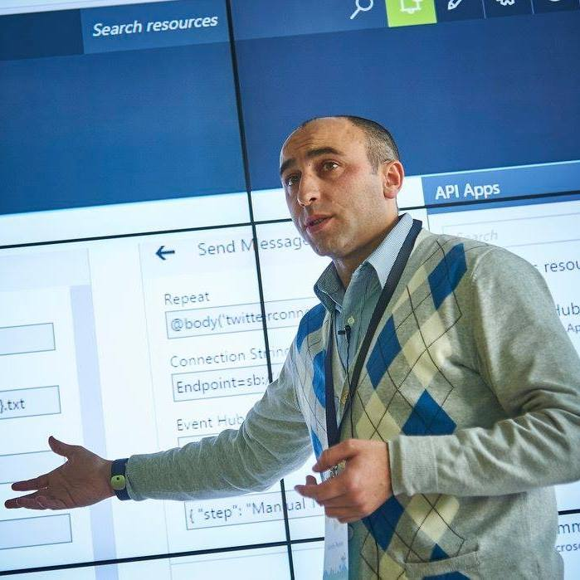


Sandro Pereira
Head of Integration @DevScope
Microsoft Azure MVP
sandro.pereira@devscope.net
linkedin.com/in/sandropereira
@sandro_asp
https://blog.sandro-pereira.com/
Public speaker
Father
Book author: “BizTalk Mapping Patterns and Best Practices”
+351 223 751 350
www.devscope.net
Notes:
Interested in all things integration – which of course includes MS Flow

Slide 4

this house have kids'…

Slide 5
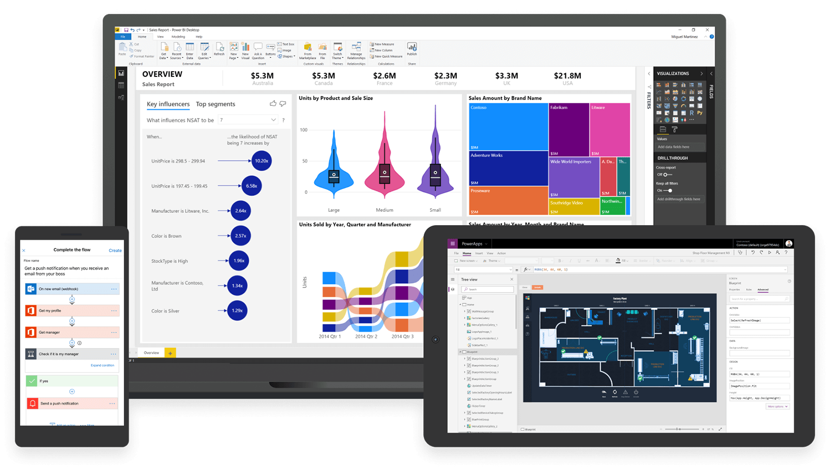
fast development….
Power
Virtual Agents
Power
Automation
Power BI
Power Apps
Dynamics 365
Microsoft
Power Platform
Office 365
Azure
Standalone Apps
Common Data Service for Apps
Data Connectors

Slide 6



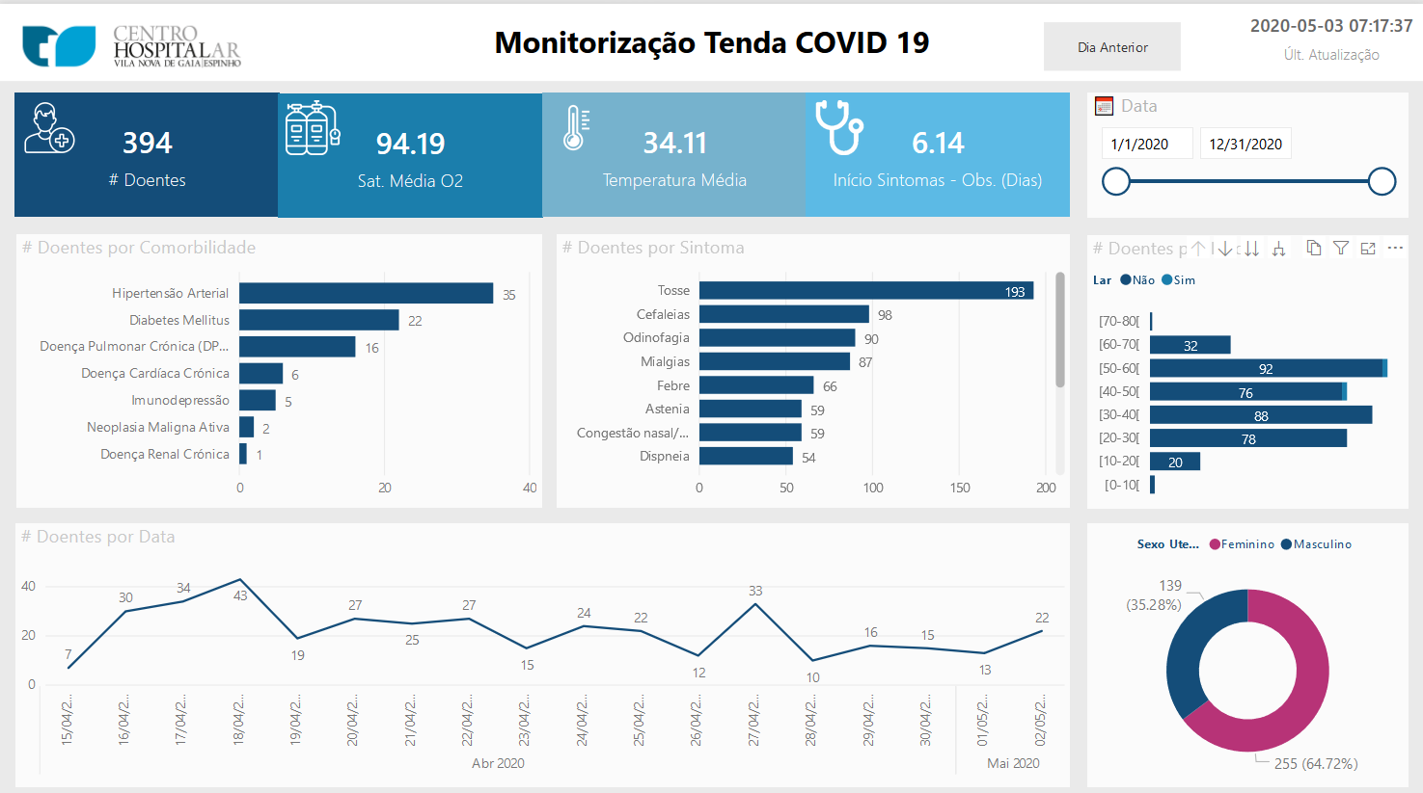
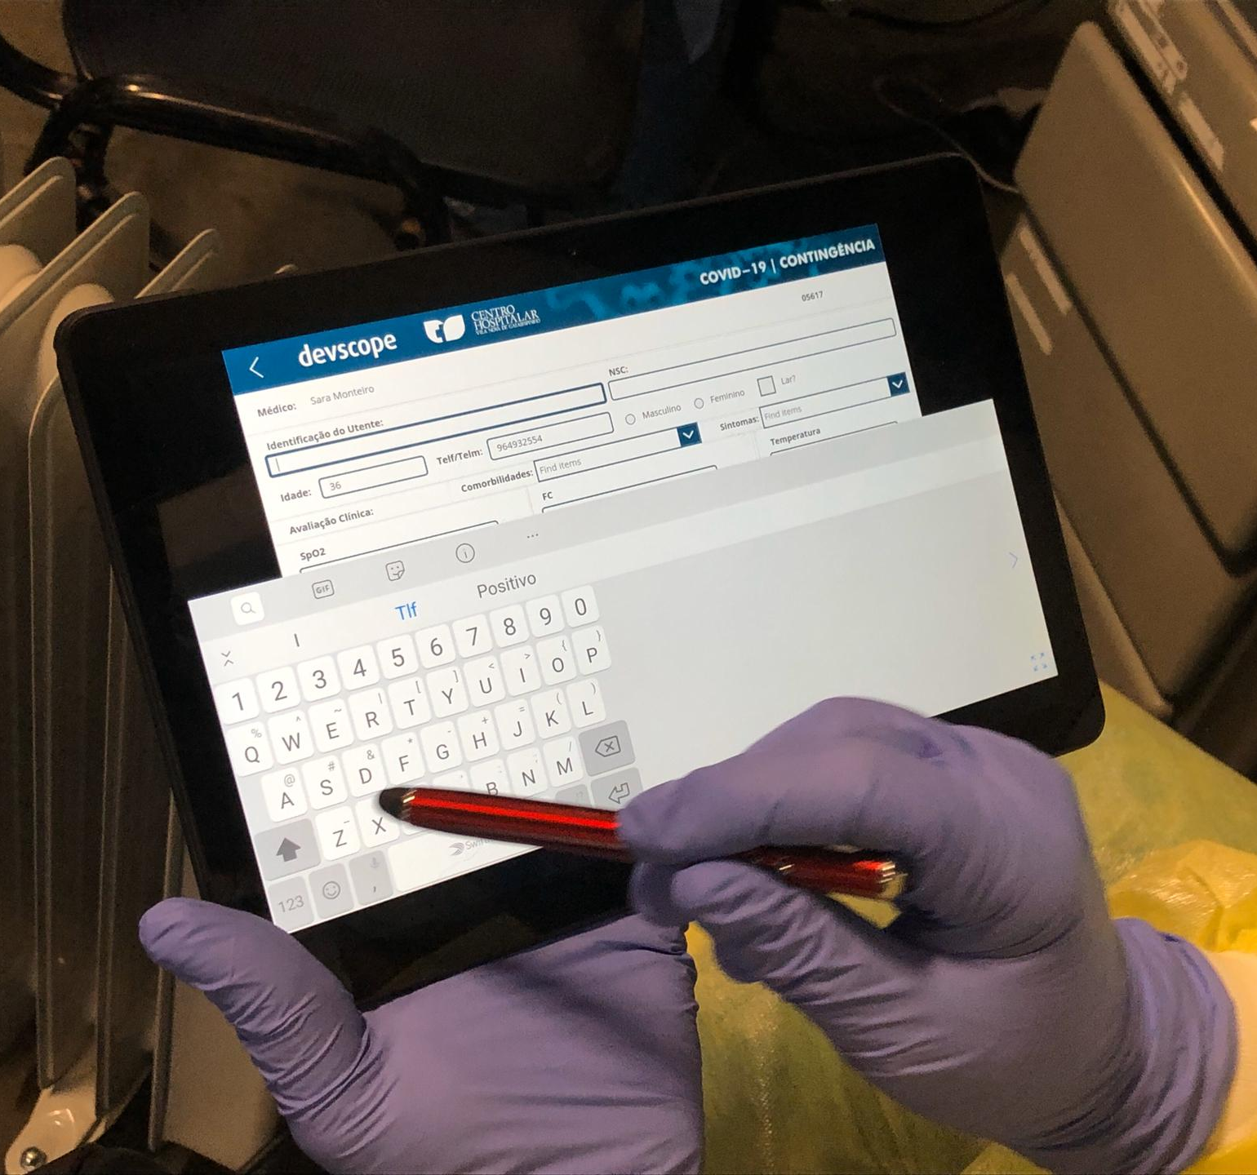
this is our fight #tech4covid19
CHVNGE

Slide 7

how are my flows?
are they reliable?
what may be wrong?

Slide 8

1
Power Automate was rebrand…
Microsoft Flow
Power Automate
→
→

Slide 9

2
Power Automate flow naming convention…
Use descriptive names
Improves readability
Transfer knowledge
You can always rename your flows without impacting what is running
You can use all types of characters

Slide 10
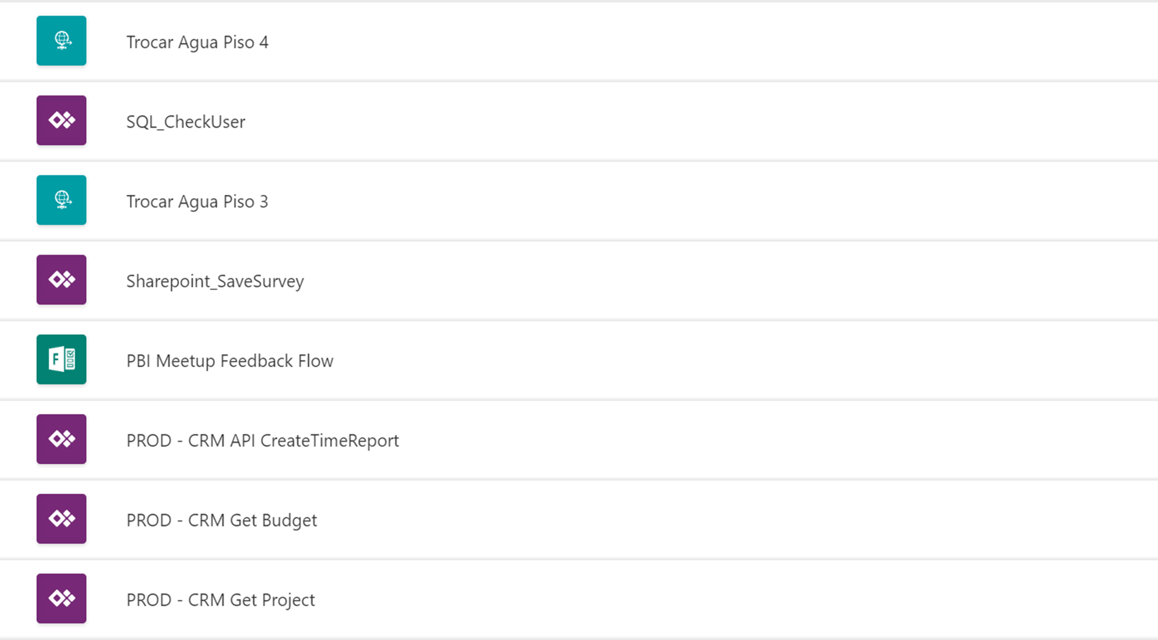

DVS ADM – Inventory – Change water bottle 4 Floor
POC CLIENT_NAME – Check if user exists
DVS ADM – Inventory – Change water bottle 3 Floor
DVS CSI – Survey Process
DVS TimeReport App – Create Time Report
DVS TimeReport App – Get Budgets by project
DVS TimeReport App – Get Project by name

Slide 11
3
actions naming convention…
Use descriptive names
Improves readability
Transfer knowledge
You can now rename actions that have dependencies… directly
The name cannot contain any control characters or any of the following symbols: '"<", ">", "%", "&", "\", "?", "/"'.

Slide 12
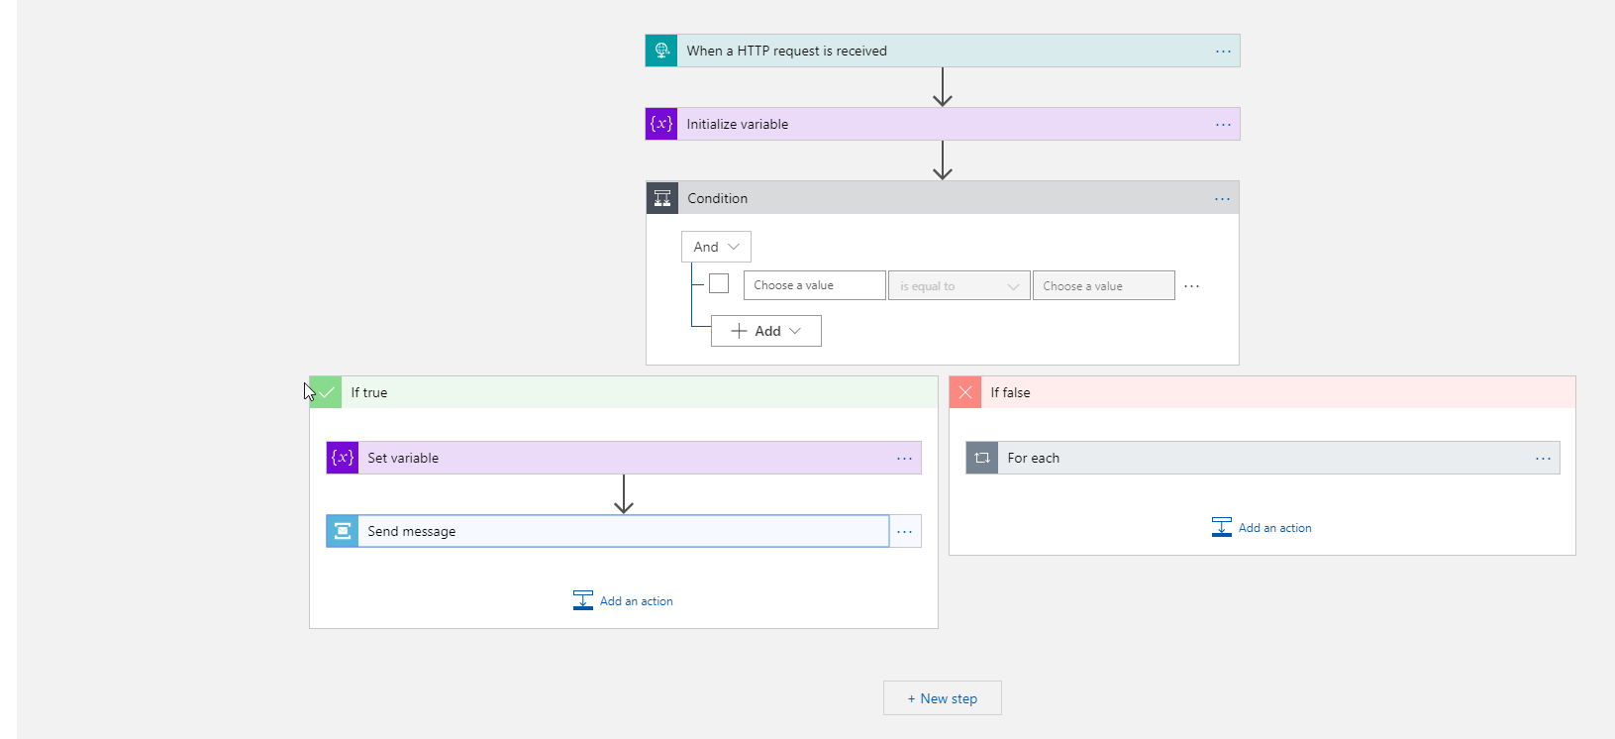
What do you see wrong?
What can we improve?

Slide 13
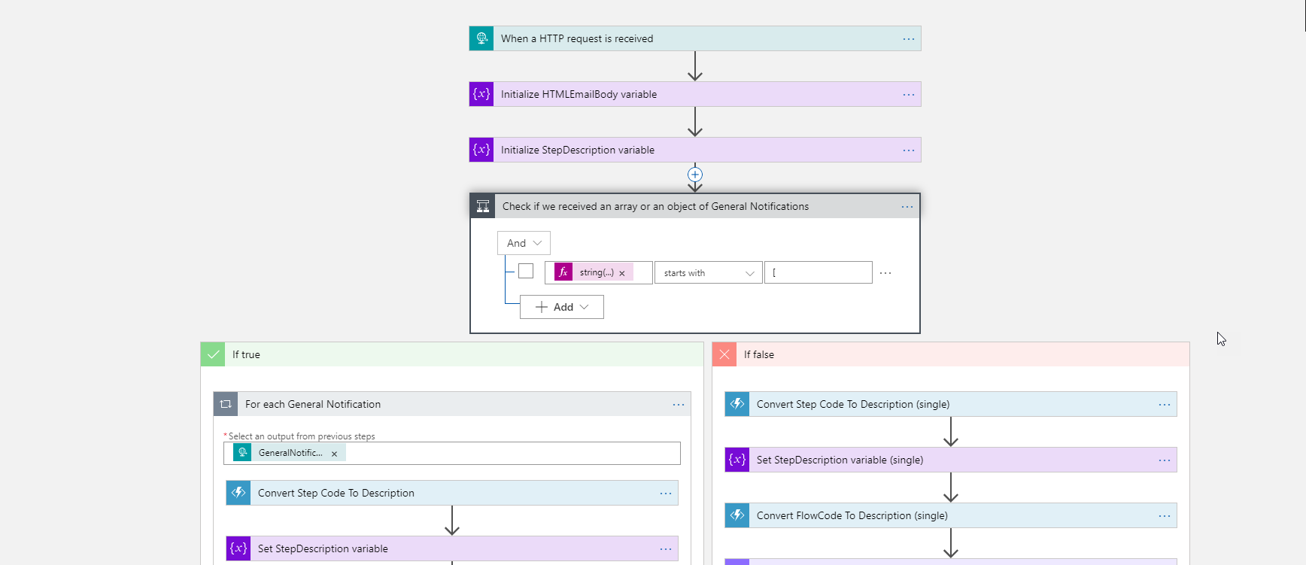
Most of the triggers don’t allow you to change the name
Outlook or Forms triggers allows

Slide 14
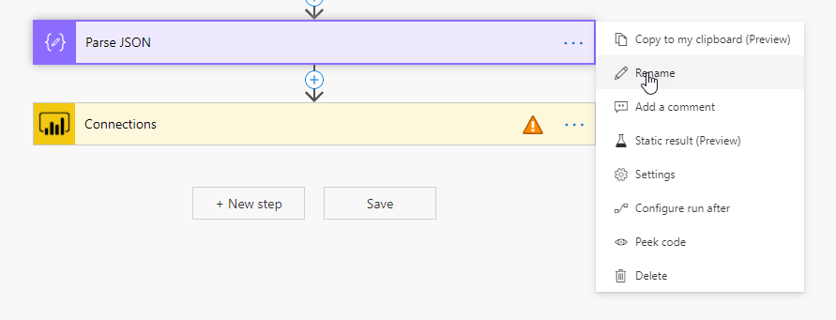
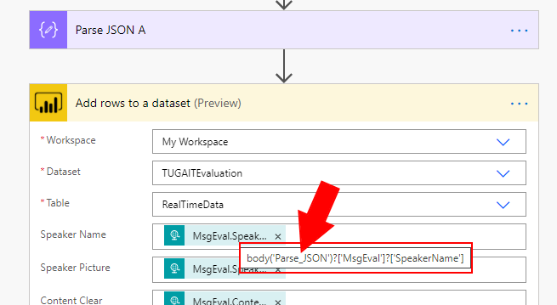
You can always rename the actions even the ones that have dependencies directly without any impact.
Never rename action names without fixing all the connectors…
especially if they have a dependency on the action, you are renaming

Slide 15

4
add comments…
Everyone can read the comments
Improves readability
Transfer knowledge
Save yourself and teammates from future frustration
Every expression should have a comment

Slide 16
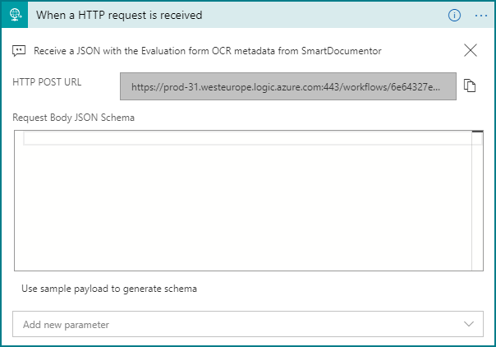
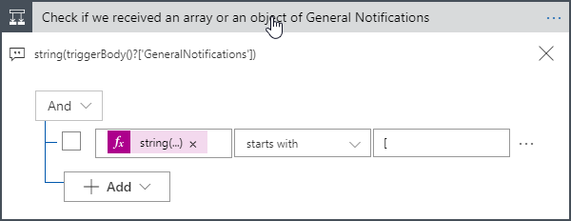
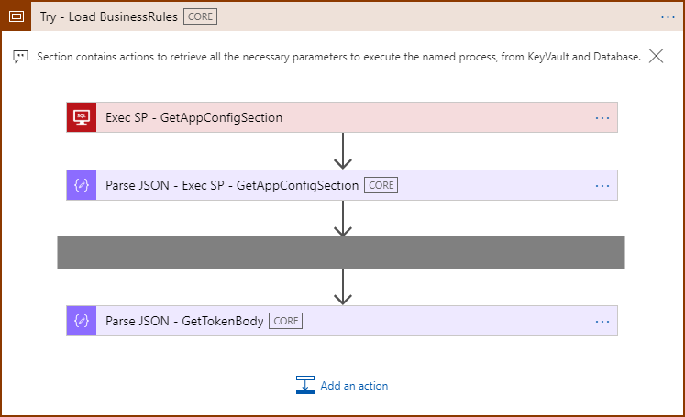
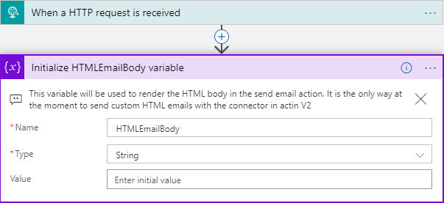

Slide 17

5
copy to my clipboard…
Easy way to Duplicate Actions or Scope
Avoid reproducing settings over and over again
Copy once, paste many times

Slide 18
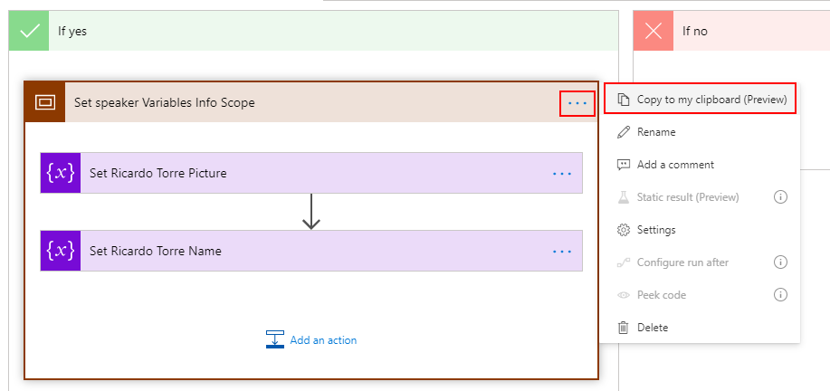
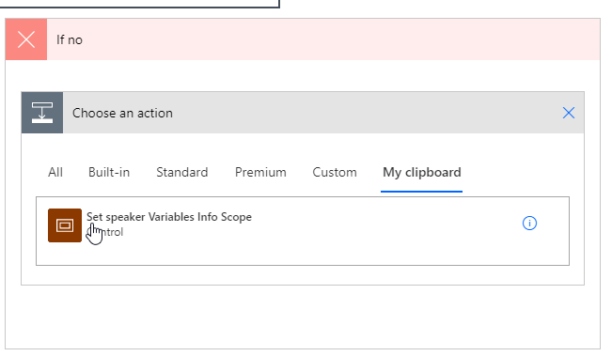
The clipboard content is available during the lifetime of your browser session…
…you can even copy and paste into different Power Automate flows.
If you refresh the browser (F5) your clipboard content will go away!

Slide 19

6
using scopes…
Managing individual actions introduces complexity
Scopes allow us to group actions together
Manage actions as a single unit instead of disparate items

Slide 20
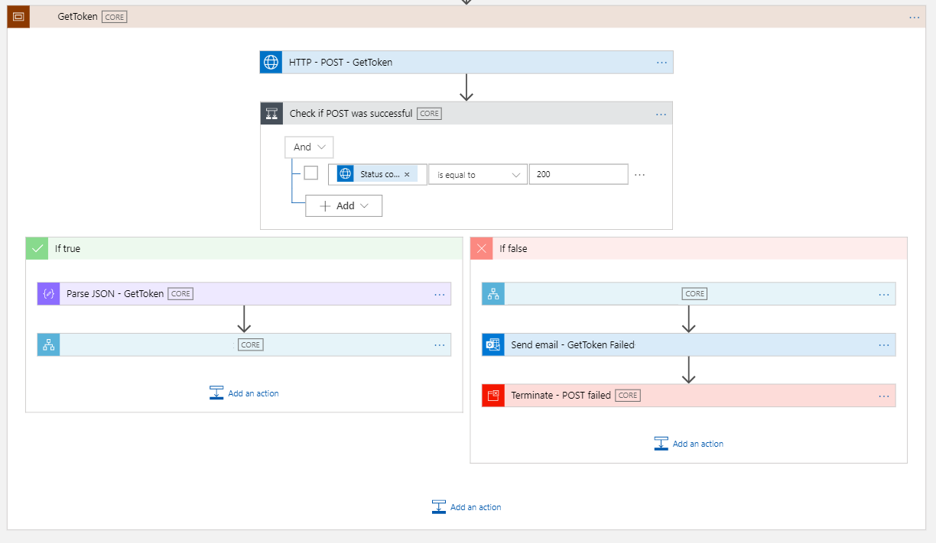

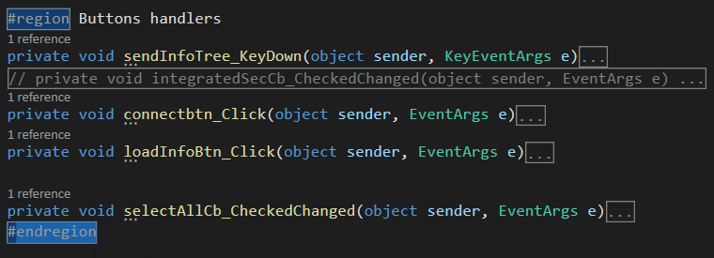
scope… is a region

Slide 21
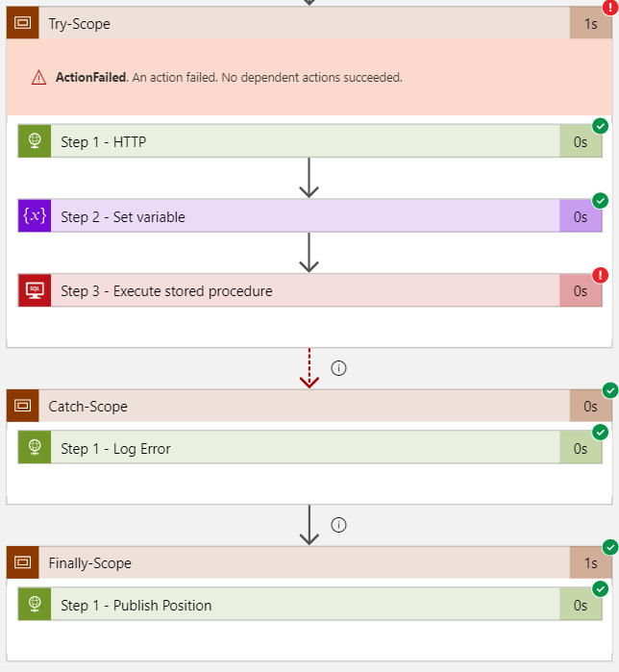
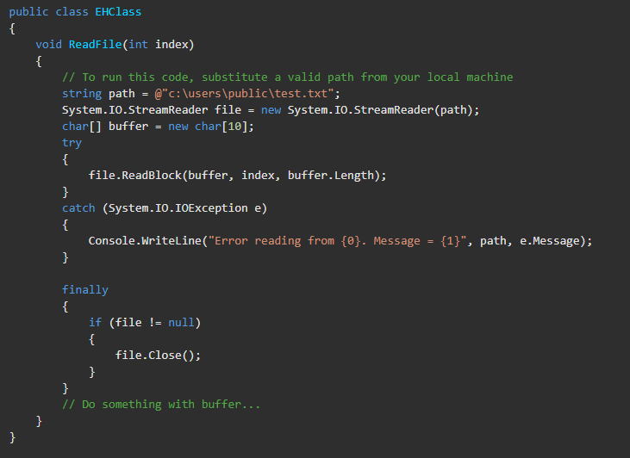
scope… is a try-catch-finally

Slide 22
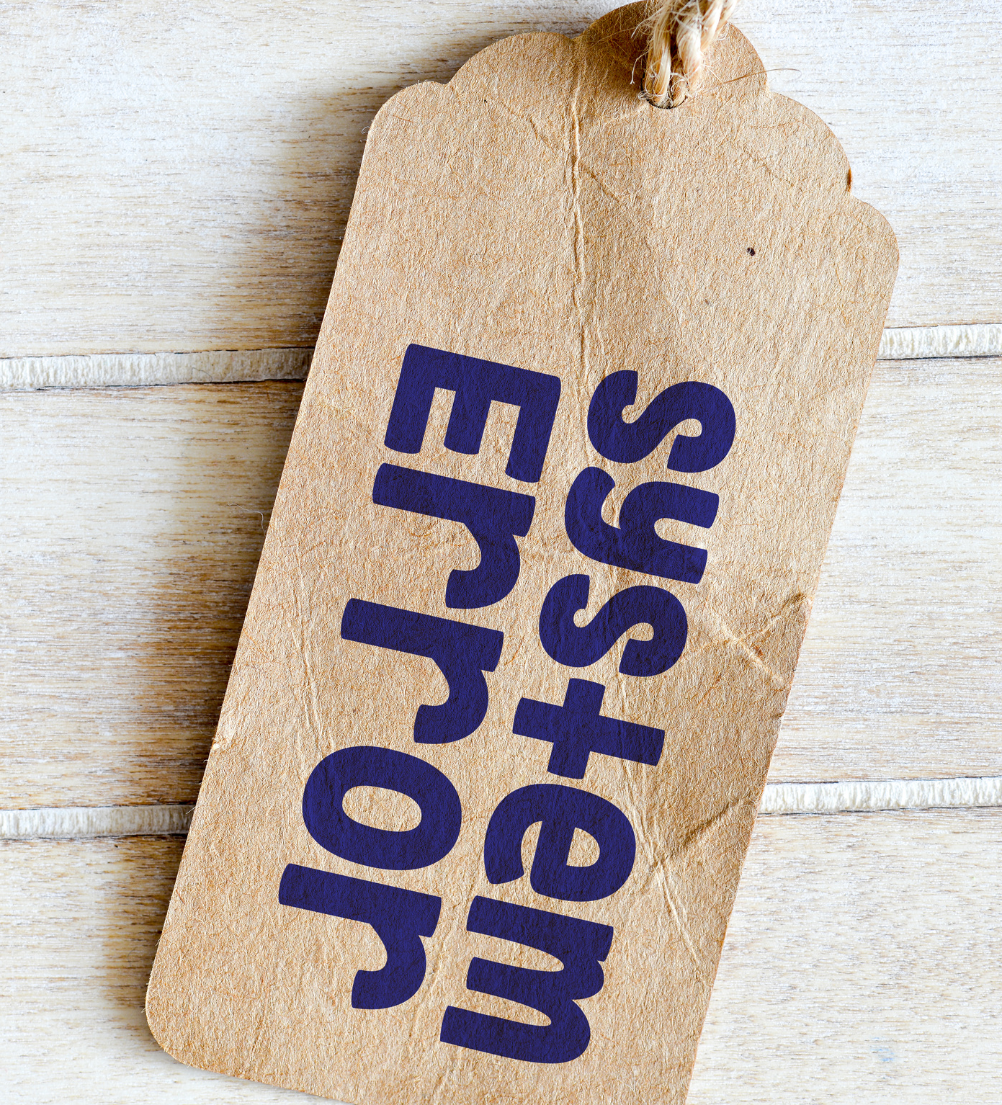
7
error handling… configure run after settings
Power Automate default response to errors from connectors is pretty simple – exit the workflow with failure right there - but it also allows you to have the:
The ability to set action(s) after a failure
Or define retry policies

Slide 23
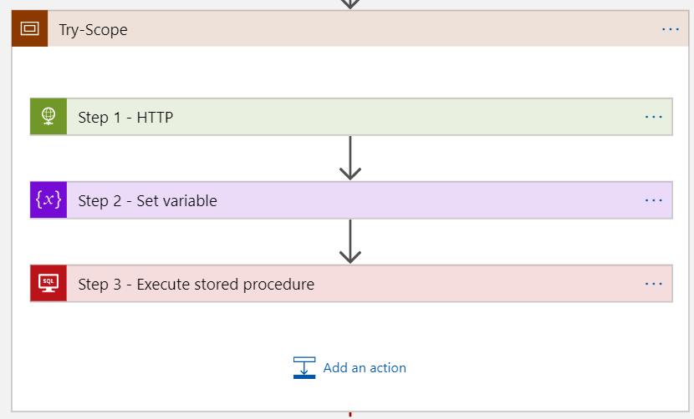
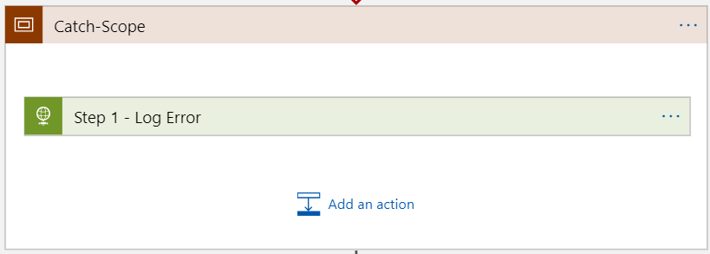
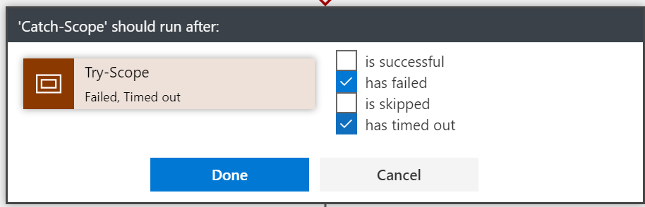
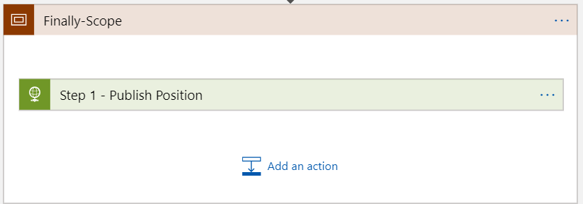
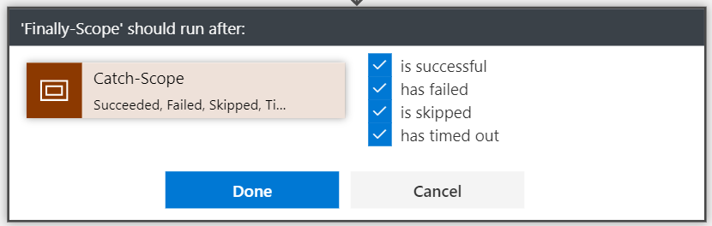

Slide 24
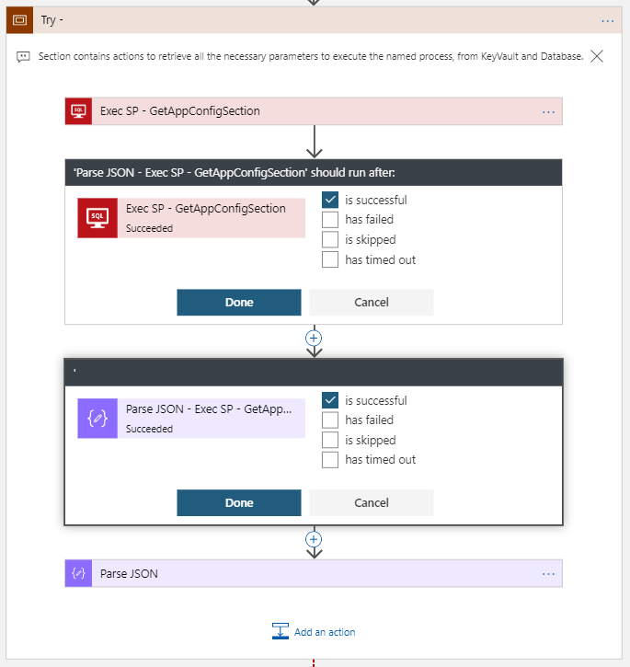
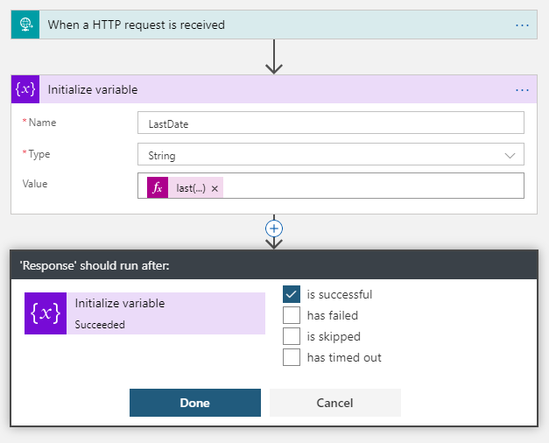

Slide 25
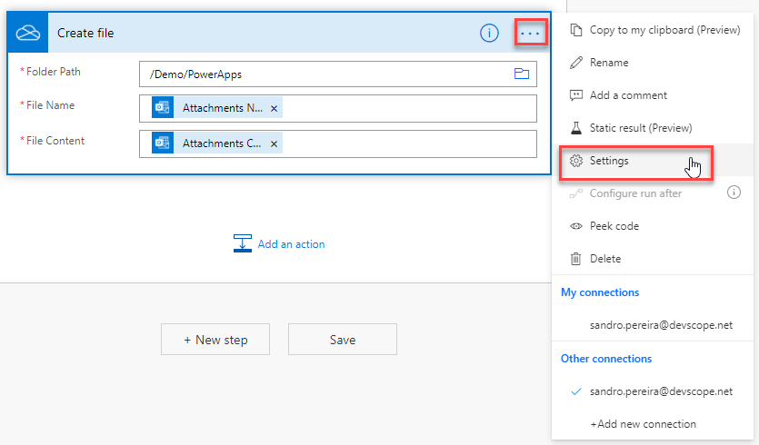
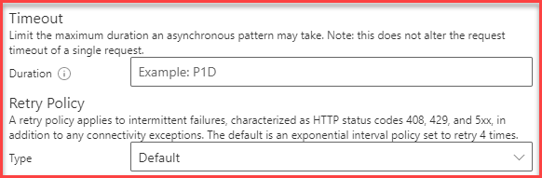
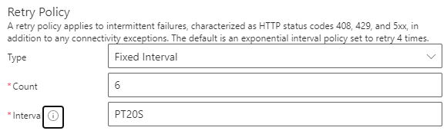
Specify interval in ISO 8601 format.
Examples:
"PT20S" -- parses as "20 seconds"
"PT15M" -- parses as "15 minutes" (where a minute is 60 seconds)
"PT10H" -- parses as "10 hours" (where an hour is 3600 seconds)
"P2D" -- parses as "2 days" (where a day is 24 hours or 86400 seconds)
"P2DT3H4M" -- parses as "2 days, 3 hours and 4 minutes"

Slide 26

8
Learn from failures…
You should analyze the run history from time to time and learn from failures… or mistakes
Flow failure is critical!
If it is failing due to expected behavior, then you must redesign your flow, so it doesn't end up in a failure status

Slide 27
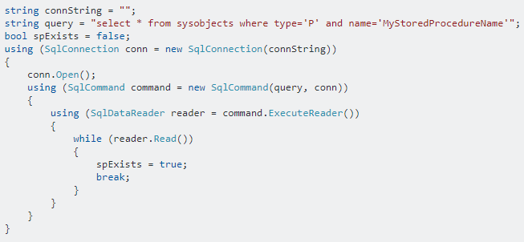
C# developer’s implement defensive code…

Slide 28
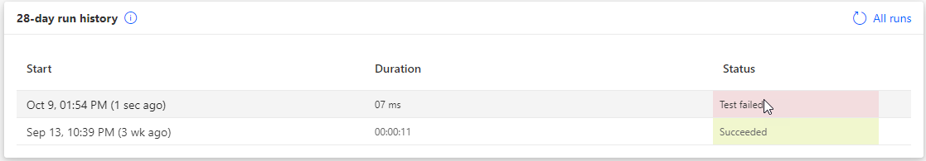
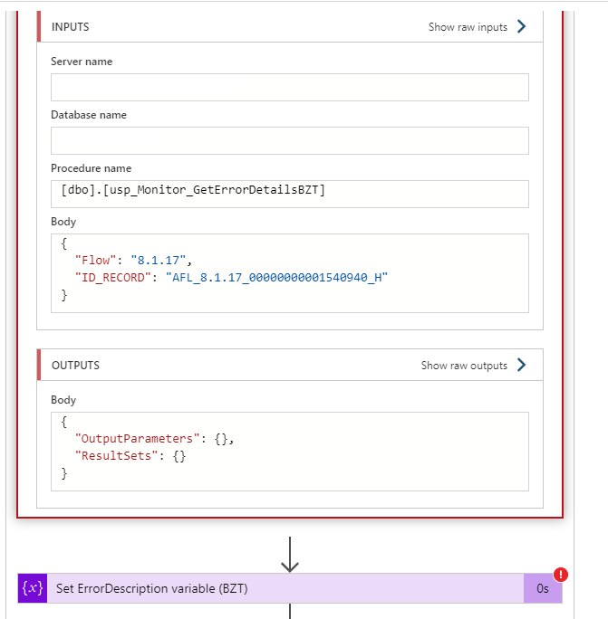
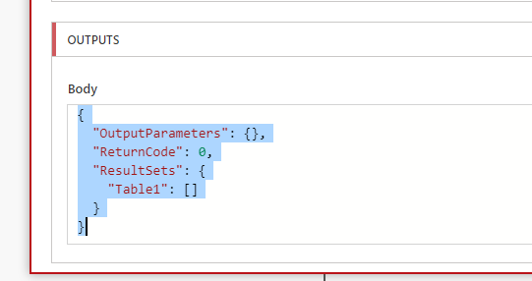
… with not in Power Automate?

Slide 29
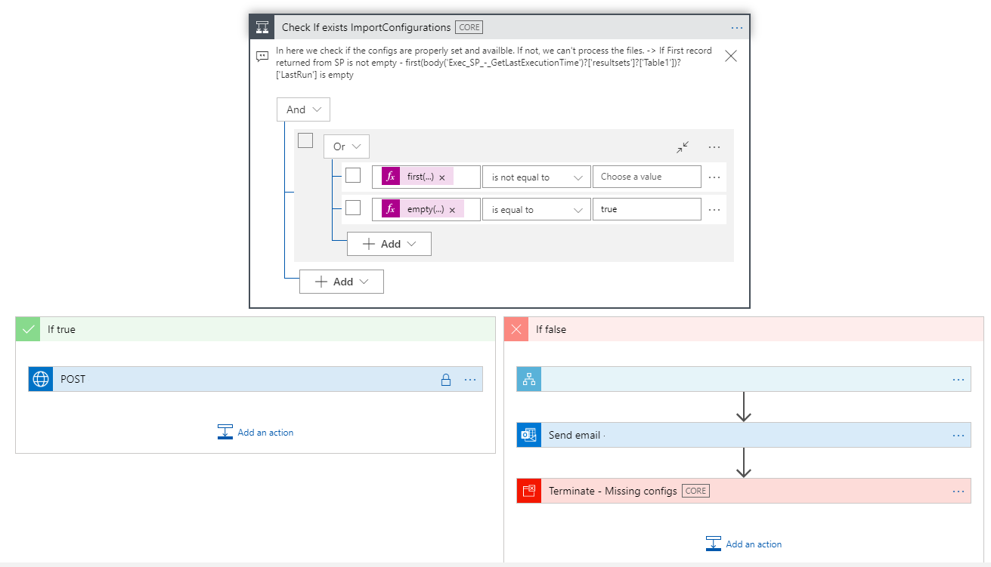
first(body('Exec_SP_-_GetLastExecutionTime')?['resultsets']?['Table1'])?['LastRun']
empty(body('Exec_SP_-_GetLastExecutionTime')?['resultsets']?['Table1'])

Slide 30

9
expressions nightmare…
Basic operations that you can use inside flow actions or conditions
Like getting the current time, adding numbers together, manipulating strings or Parsing XML
They are part of the engine

Slide 31
body('Execute_SP_-_Get_BZT_lock_error_details')
Name of the actions with the space replace by underscore

Slide 32
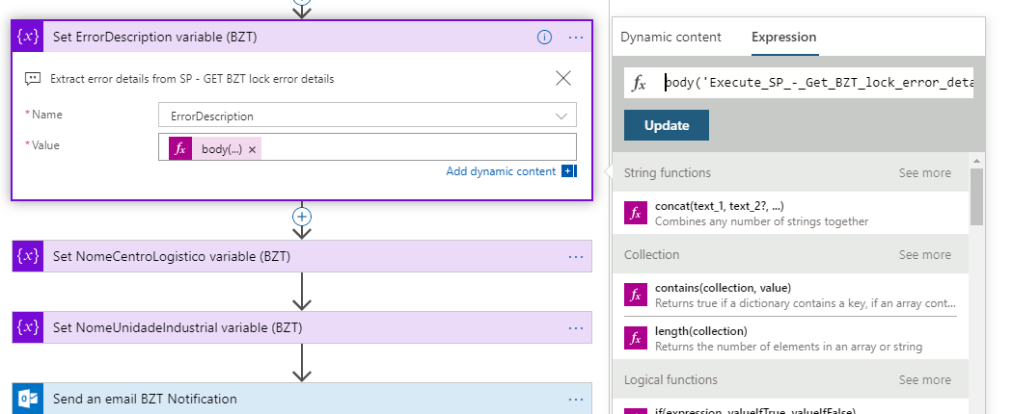
body('Execute_SP_-_Get_BZT_lock_error_details')?['ResultSets']?['Table1'][0]?['ErrorDescription’]
concat(div(sub(ticks(utcNow()), ticks(item()?['Created'])), 10000000), ' segundo(s)')
int(div(add(add(int(variables('ContentClear')), int(variables('GoodCommunicator'))) , add(int(variables('EnjoySession')), int(variables('MetExpectation')))),4))

Slide 33
int(
div(
add(
add(
int(variables('ContentClear')),
int(variables('GoodCommunicator’))
) ,
add(
int(variables('EnjoySession')),
int(variables('MetExpectation’))
)
)
,4
)
)

Slide 34

10
flow checker…
Flow Designer performs design-time checks against your flow for design issues
Prescriptive guidance on how to fix
Errors put into focus to save your time and frustration

Slide 35
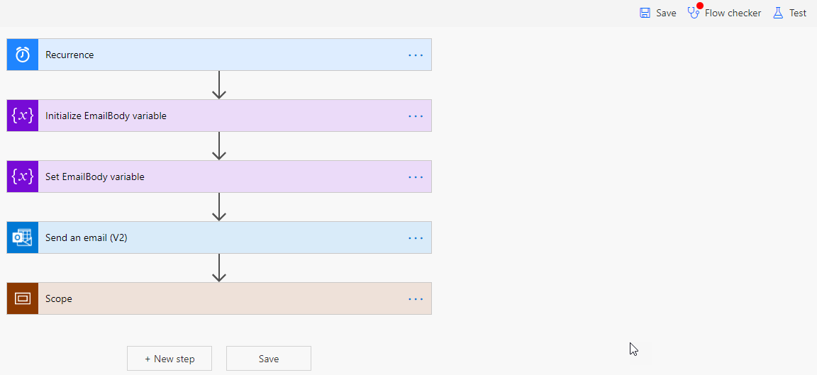
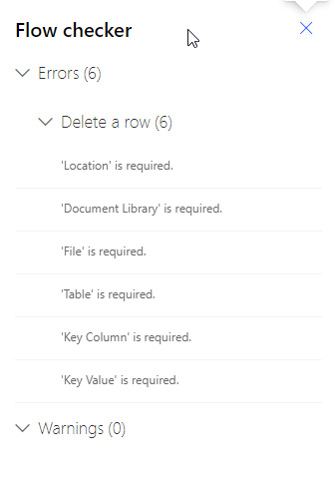
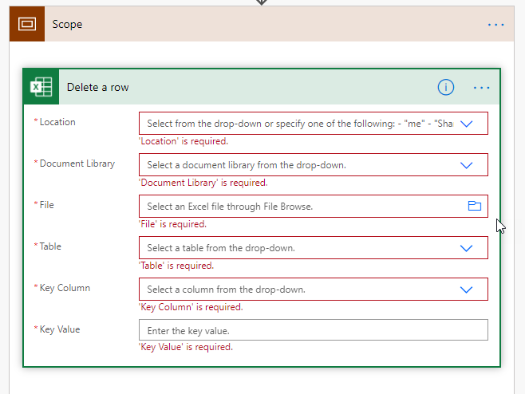

Slide 36

11
send a copy…
Share a flow, without sharing a connection
Avoid connection/data leakage
Copy becomes disconnected from the original
Efficient and effective
You are sharing the flow template

Slide 37
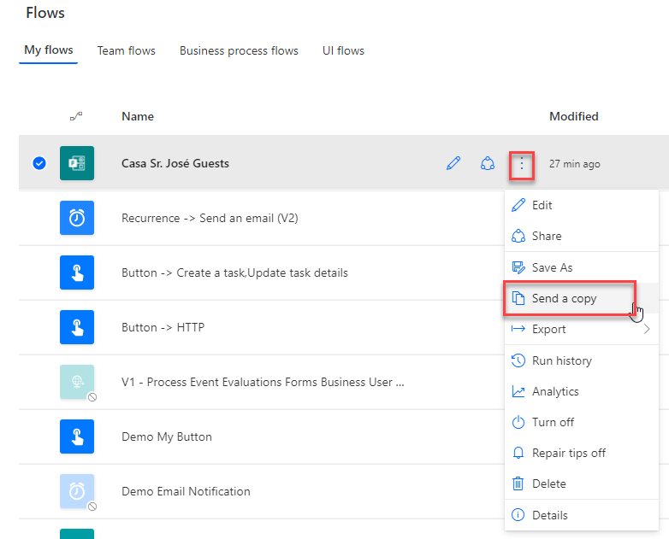
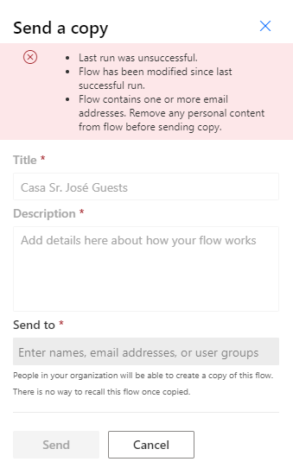
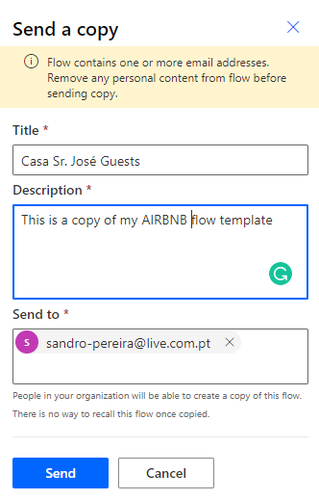

Slide 38

12
Share with other users or security groups…
Share a flow between your team or company
Be aware of connection/data leakage
Work as a team
You are sharing the flow process

Slide 39
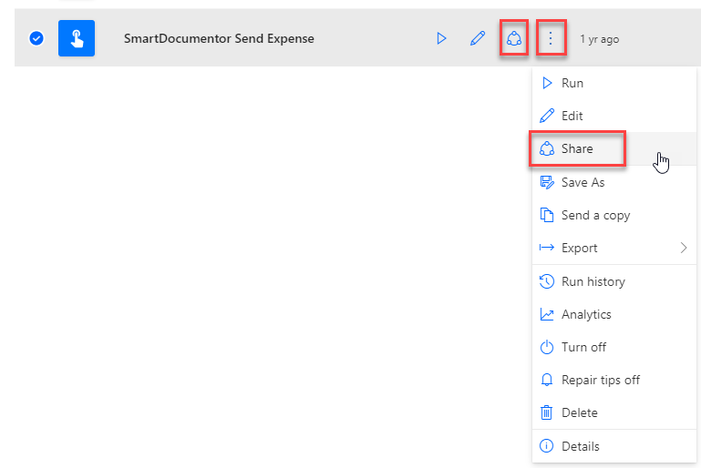
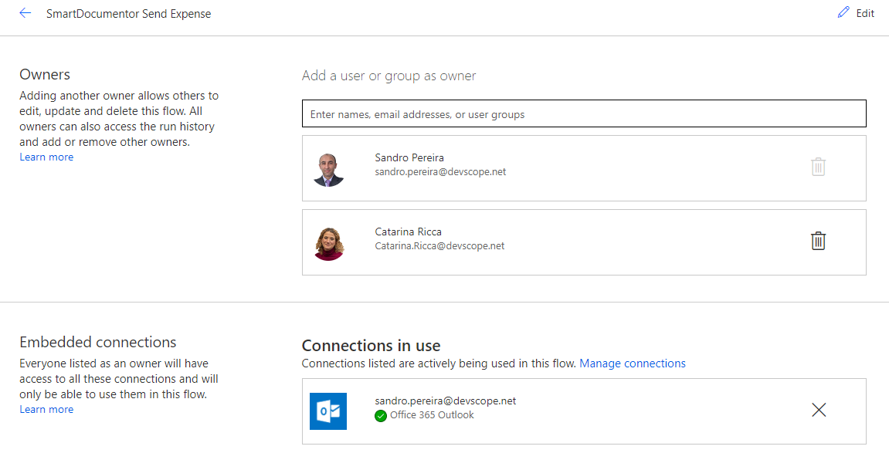

Slide 40
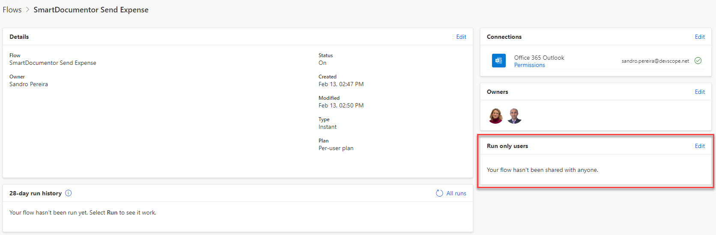
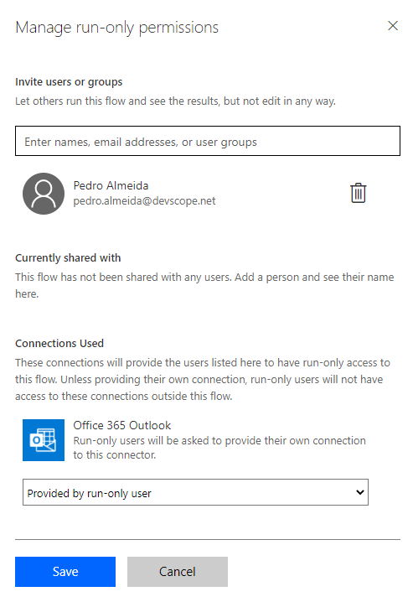

Slide 41
Our Sponsors
DIAMOND
COMMUNITY

Slide 42



DevScope
+351 223 751 350
support@devscope.net
https://pt.linkedin.com/company/devscope
@DevScope
www.devscope.net
Thanks!
Sandro Pereira
sandro.pereira@devscope.net
linkedin.com/in/sandropereira
@sandro_asp
https://blog.sandro-pereira.com/

Slide 43


